Slide 1
Samba KCC: Saying No to Full Mesh Replication
Garming Sam
Catalyst IT, Samba Team

Slide 2
History of the Samba KCC
Easy to debug your own bugs, not someone else
Dot graph
Avert some of these bounces outside of KCC

Slide 3
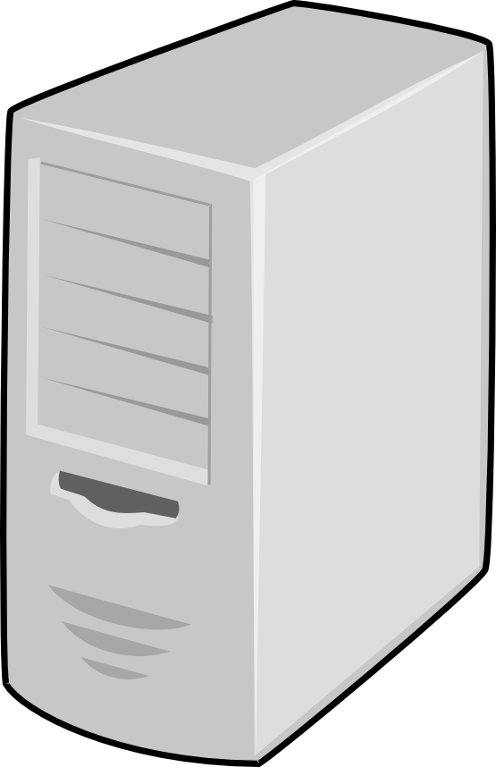
What is the KCC?
Knowledge consistency checker
Used to manage replication connections in AD
Set of algorithms to produce efficient network topologies
Site B
Site D
Site A
Site C

Slide 4
What is the KCC?

Slide 5
What is the KCC?

Slide 6
What is the KCC?

Slide 7
What is the KCC?

Slide 8
History of the KCC
Original full-mesh C code
Attempt at MS-ADTS algorithms in C
Dave Craft (2011) in Python inter-site algorithms
Late 2014—Early 2015 Douglas and myself
Samba 4.3 introduced, Samba 4.5 set as default

Slide 9
Intra-site algorithm
Ring topology, with a few extra connections

Slide 10
Inter-site algorithm
Stable answer across entire DC network

Slide 11
Inter-site algorithm
Site B
Site A
Site C
Site D
Bridgehead servers are the end-point connections between sites.

Slide 12
Inter-site algorithm
Site B
Site A
Site C
Site D
There is not necessarily a single bridgehead server.

Slide 13
Remove unneeded connections
Stable answer across entire DC network
Used to manage replication connections in AD
Set of algorithms to calculate efficient network topologies

Slide 14
Translate connections
Stable answer across entire DC network
Used to manage replication connections in AD
Set of algorithms to calculate efficient network topologies

Slide 15
With Samba 4.5, the new site-aware Samba Knowledge Consistency Checker (KCC) has been turned on by default. Instead of using full mesh replication between every DC, the KCC will set up connections to optimize replication latency and cost (using site links to calculate the routes). Although there is more effort required in establishing effective site topologies, it has enabled users to create larger and more distributed networks without any of the previous replication penalties. It has also meant that Samba AD can be aware of particular details of a network (such as satellite links or certain firewall restrictions) to ensure that information flows through the network in a reasonable way. The aim is to look at how sites in AD generally work, what role the KCC performs, and what implications this new feature has on a range of different networks.

Slide 16

Hyperedge and hypergraphs

Slide 17
Internal consitencies, it's hard to say what actually needs to be corrected.

Slide 18
2637 # Step 1
2638 self.refresh_failed_links_connections(ping)
2640 # Step 2
2641 self.intrasite()
2643 # Step 3
2644 all_connected = self.intersite(ping) # overlay a failed network ontop of the expected
2646 # Step 4
2647 self.remove_unneeded_ntdsconn(all_connected)
2649 # Step 5
2650 self.translate_ntdsconn()
2652 # Step 6
2653 self.remove_unneeded_failed_links_connections()
2655 # Step 7
2656 self.update_rodc_connection()

Slide 19
i1929 The KCC does not create more than 50 edges directed to a
1930 single DC. To optimize replication, we compute that each node
1931 should have n+2 total edges directed to it such that (n) is
1932 the smallest non-negative integer satisfying
1933 (node_count <= 2*(n*n) + 6*n + 7)

Slide 20
Select ITSG
1140 An intersite graph has a Vertex for each site object, a
1141 MultiEdge for each SiteLink object, and a MutliEdgeSet for
1142 each siteLinkBridge object (or implied siteLinkBridge). It
1143 reflects the intersite topology in a slightly more abstract
1144 graph form.

Slide 21
White, red black color vertex

